Slide 1
Compare to The Knowledge: Graph Neural Fake News Detection with External Knowledge
Linmei Hu, Tianchi Yang, Luhao Zhang, Wanjun Zhong, Duyu Tang,
Chuan Shi, Nan Duan, Ming Zhou
School of Computer Science, Beijing University of Posts and Telecommunications
Meituan Sun Yat-sen University Microsoft Research Asia
ACL 2021
Code: https://github.com/ytc272098215/FakeNewsDetection
Zhuomin Chen
2021.10.10

Slide 2
Introduction

Slide 3
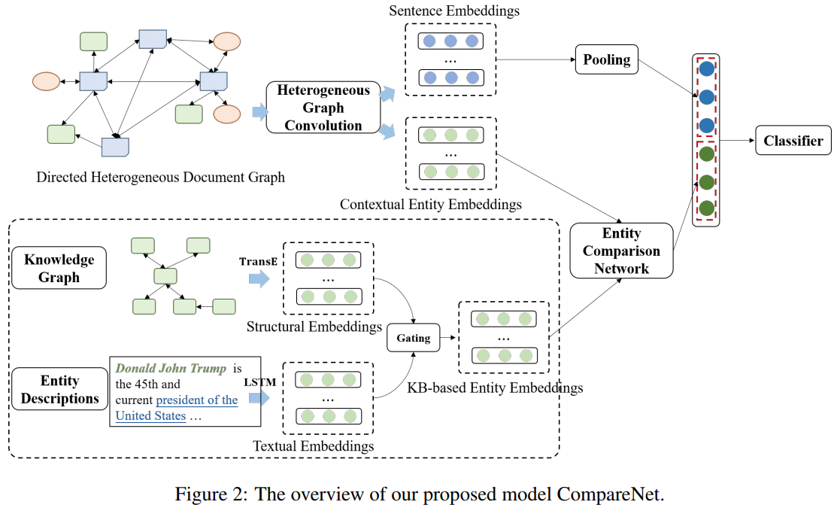

Slide 4
Directed Heterogeneous Document Graph
Directed heterogeneous document graph

Slide 5
Heterogeneous Graph Convolution
Three types of nodes
Attention matrix
Sentence feature vector
Type-level attention weight
Topic one-hot vector
Max pooling
Contextual entity representations

Slide 6
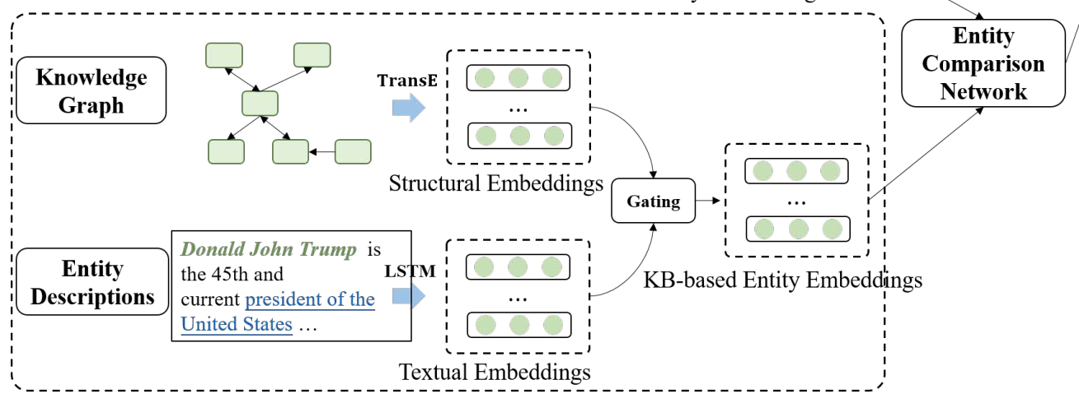
Entity Comparison Network
Gating:
Gating vector：
Real-value vector
Comparison vector
Comparison function
Max pooling

Slide 7
Model Training

Slide 8
Experiments

Slide 9
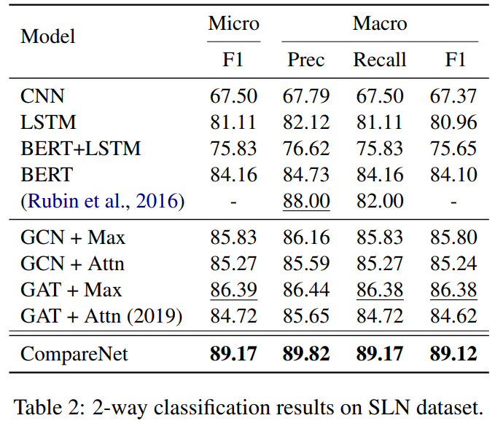
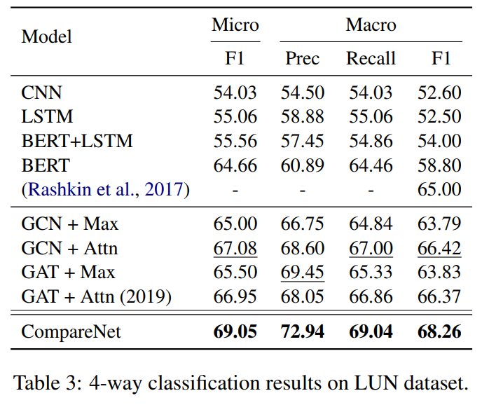
Experimental Results

Slide 10
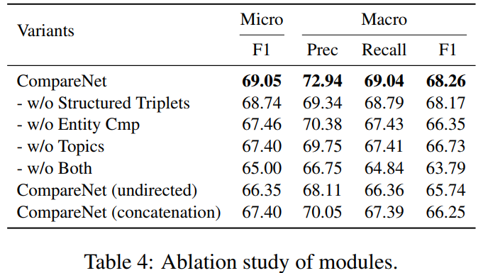
Ablation Study

Slide 11
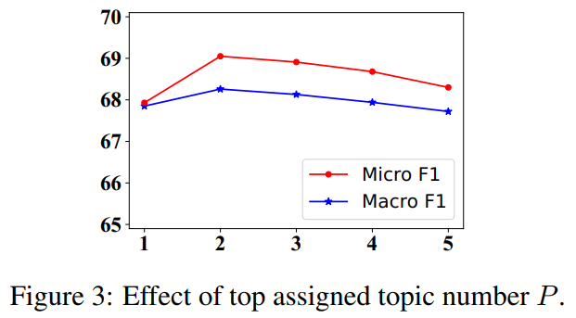
Analysis of Top Assigned Topic Number

Slide 12
Case Study

